Slide 1
POINT-OF-SALE SYSTEM
FOR SMALL BUSINESS
SORIANO, JANNAH R.
TORRES, ROSH HASHANA S.

Slide 2
01
INTRODUCTION

Slide 3
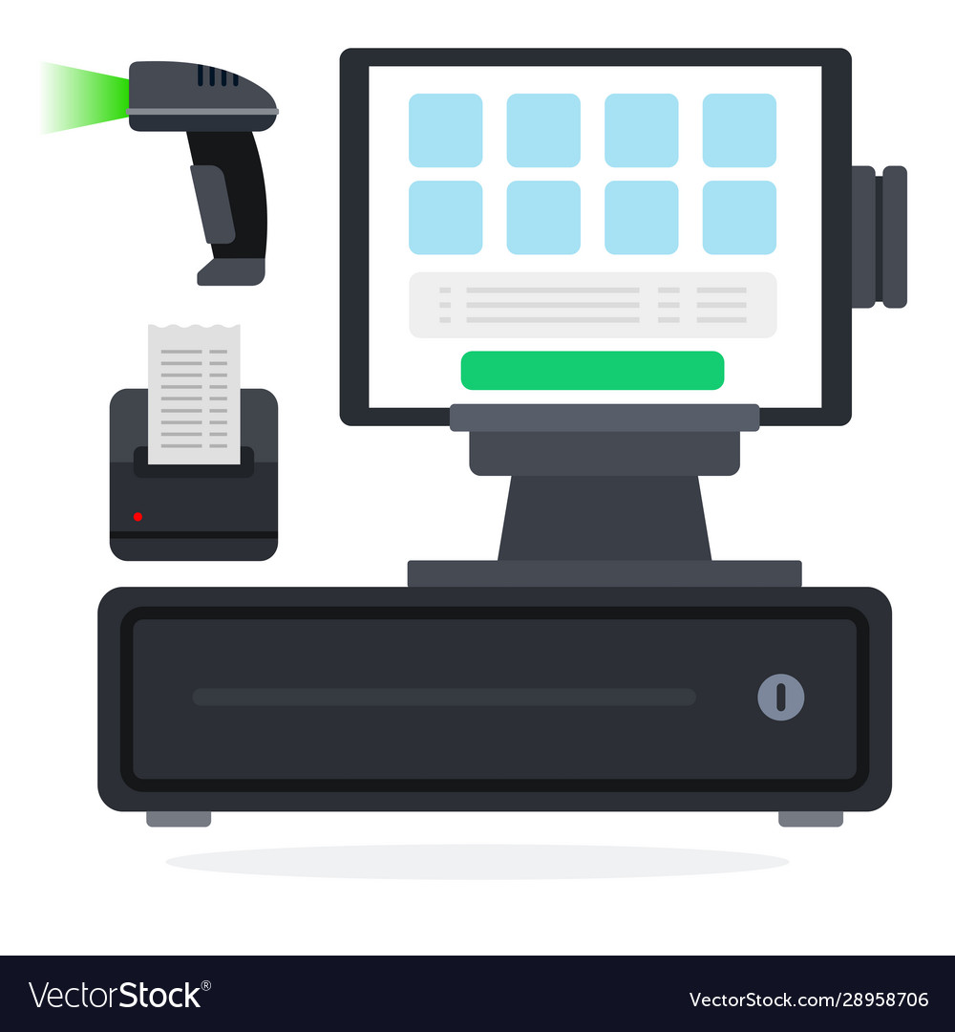
INTRODUCTION
A Point-of-Sale (POS) is a place where a customer executes the payment for goods or services and where sales taxes may become payable.
Over time, technology is growing so fast. Likewise, the technology in running trade or sale. Errors in recording, the calculation is less precise, speed in service is often constrained in the Micro, Small and Medium Enterprises and even in small businesses particularly in trade or sale.
A lot of small businesses still use the manual recording in their sales transactions and sales reports. This main problem can be solved by providing training in terms of management and partnership, in addition to all aspects of marketing and production even is utilize by relying on technology penetration.

Slide 4
02
SCOPE AND LIMITATION

Slide 5
SCOPE
The Point-of-Sale System is intended for small business enterprises as it only has limited functionalities. This system shows the price list and allows the printing of order lists and the creation of receipts based on the transactions performed. It calculates simple sales transactions showing the total amount of sale, customer’s mode of payment, and change.

Slide 6
LIMITATION
The Point-of-Sale System does not cover the backtracking of the transaction history. As it only provides simple calculations and limited functionalities, it cannot cover large business enterprises. Furthermore, the inventory of the products is not recorded in the system.

Slide 7
03
SYSTEM LAYOUT

Slide 8
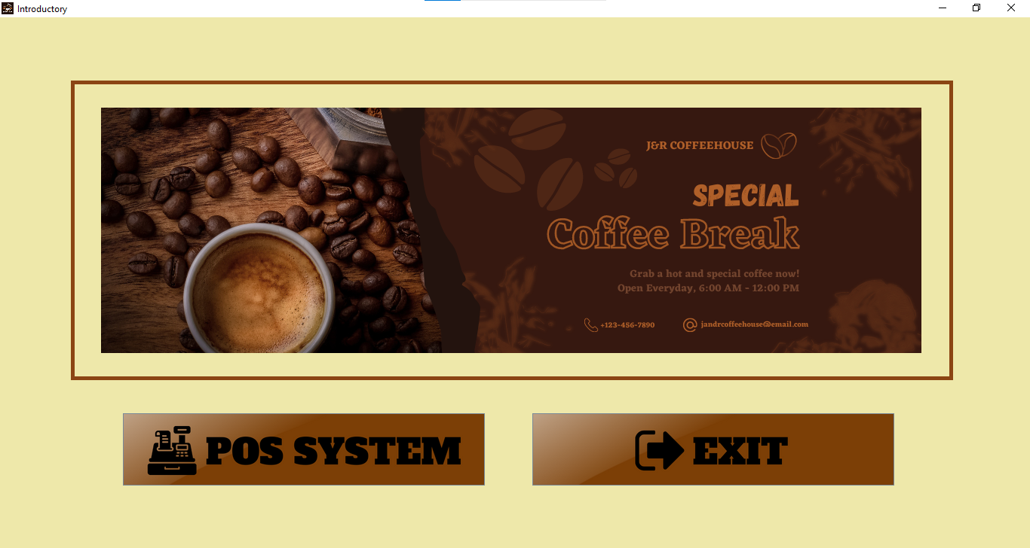
SYSTEM LAYOUT
Introductory
Window

Slide 9
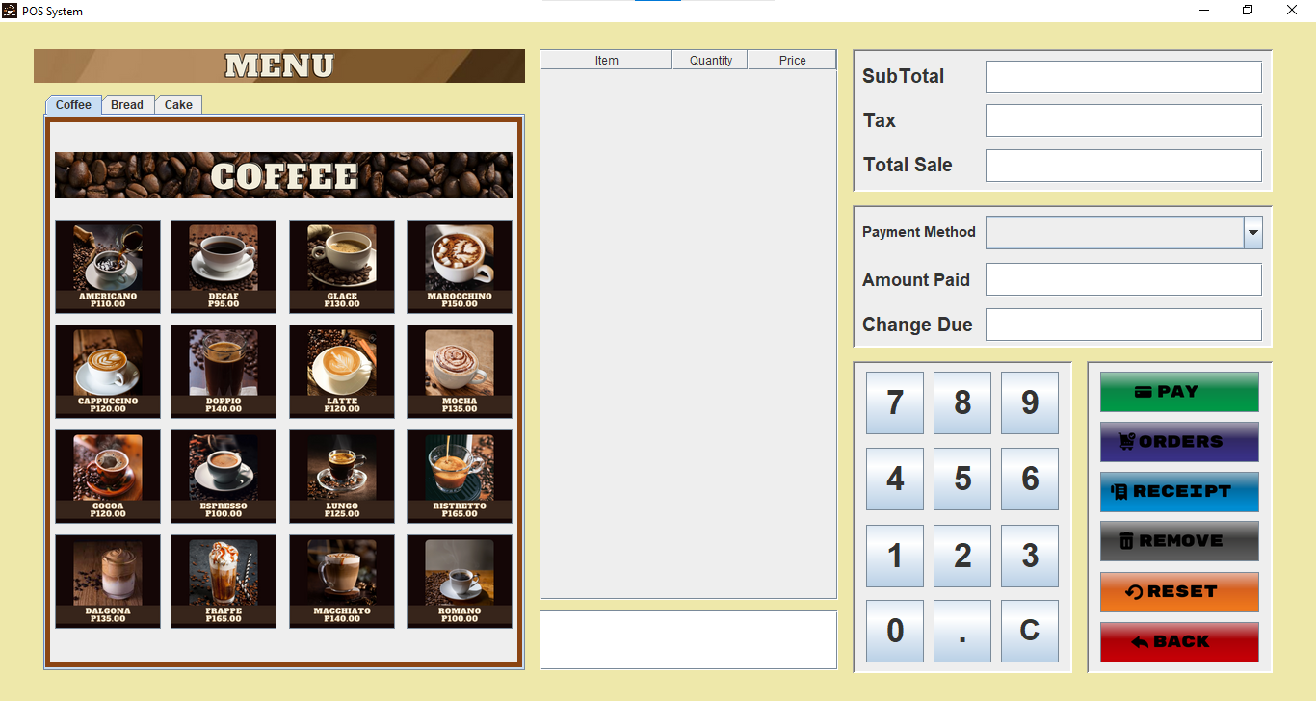
SYSTEM LAYOUT
Main
Window -
POS System

Slide 10
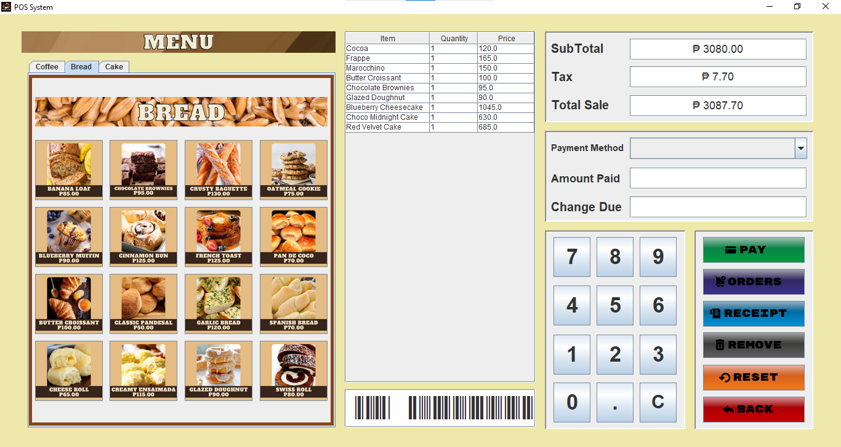
SYSTEM LAYOUT
Main
Window -
POS System

Slide 11
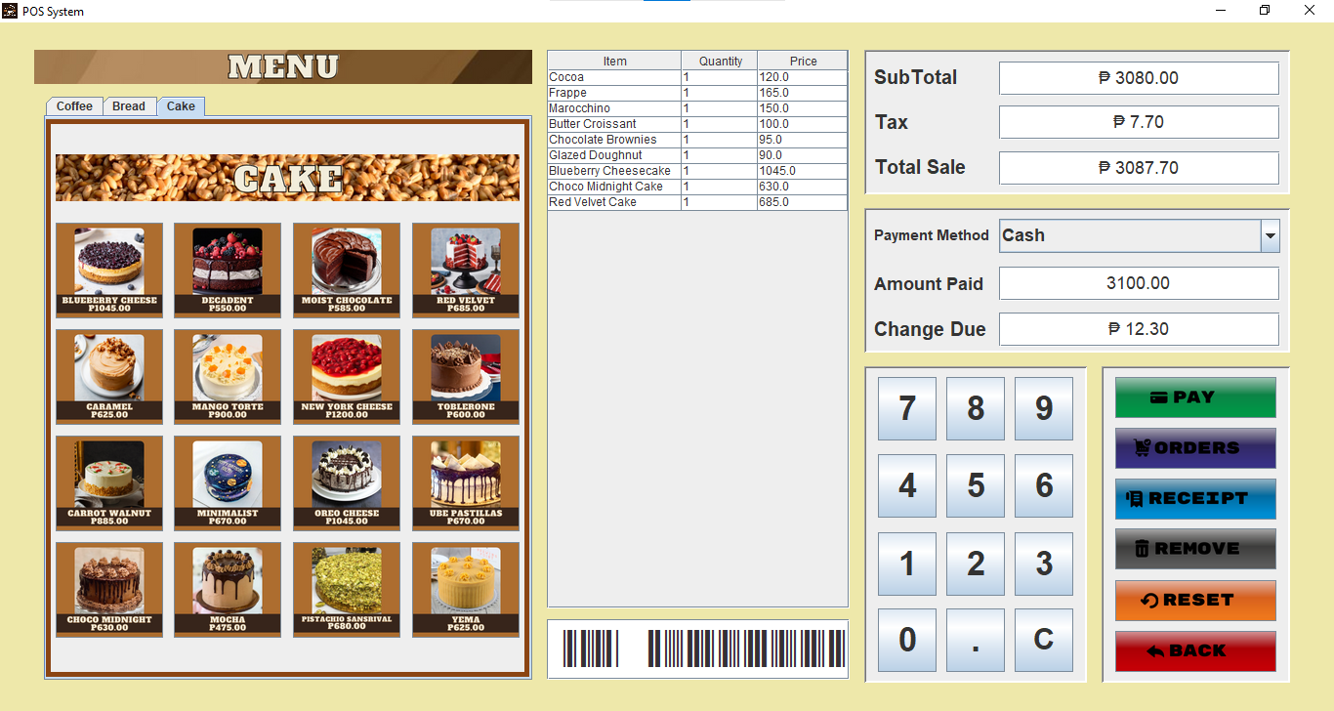
SYSTEM LAYOUT
Main
Window -
POS System

Slide 12
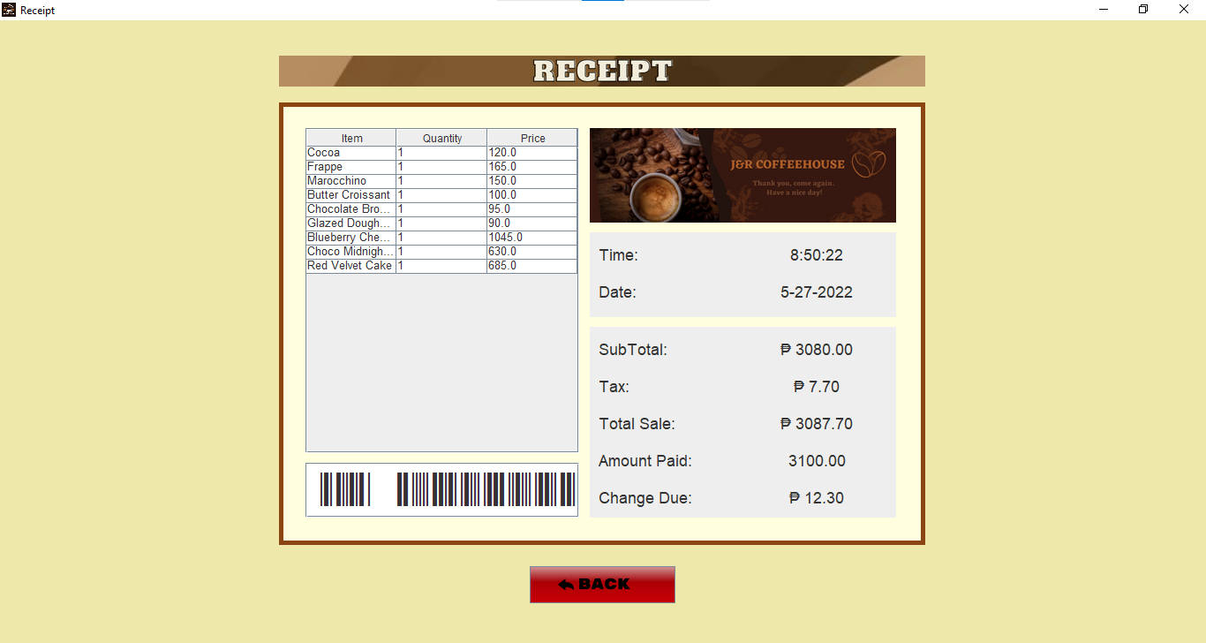
SYSTEM LAYOUT
Receipt Window

Slide 13
04
OOP CONCEPTS

Slide 14
OOP CONCEPTS
A class describes how a specific sort of object will appear. A declaration and a definition make up a class description. Objects are instances of a class created with specifically defined data. It can correspond to real-world objects or an abstract entity.

Slide 15
OOP CONCEPTS
A method is a collection of statements that perform some specific tasks and return the result to the caller. It can perform some specific tasks without returning anything.

Slide 16
OOP CONCEPTS
Encapsulation works by combining the scripts and manipulating the data in one location while keeping them safe from outside interaction and misuse. It also refers to allowing the user to access and modify the state of an object through their actions. Also, it is used to hide the values or state of a structured data object inside a class, preventing unauthorized parties' direct access to them.

Slide 17
OOP CONCEPTS
Inheritance is a concept that acquires the properties from one class to other classes. In Java, a class can inherit attributes and methods from another class. The class that inherits the properties is known as the sub-class or the child class. The class from which the properties are inherited is known as the superclass or the parent class. The properties of the base class are acquired by the derived classes.

Slide 18
OOP CONCEPTS
Polymorphism is a crucial notion. It merely indicates that there are multiple forms. That is, in different contexts, the same entity like method, operator, or object might perform multiple activities. It allows you to use these inherited properties to perform different tasks. Thus, allowing you to achieve the same action in many ways.

